Slide 1

A Carnival Curriculum
Should Caribbean Carnival be TAUGHT on the National Curriculum?

Slide 2
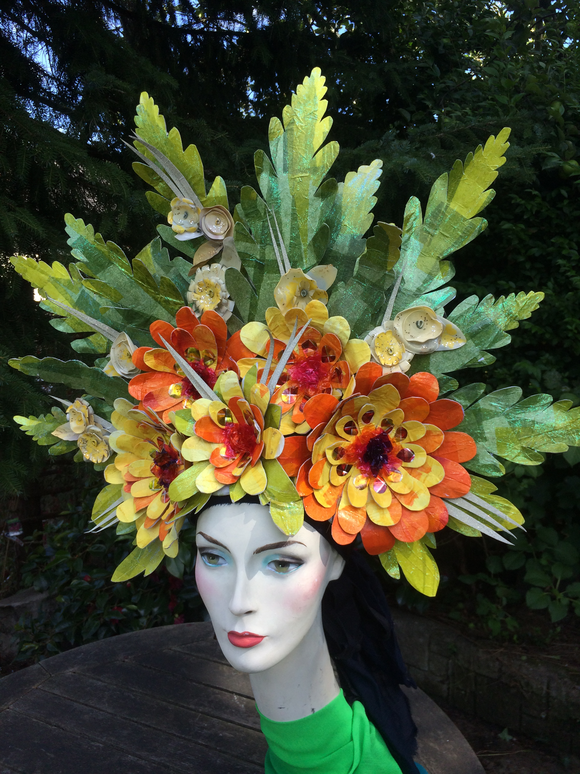
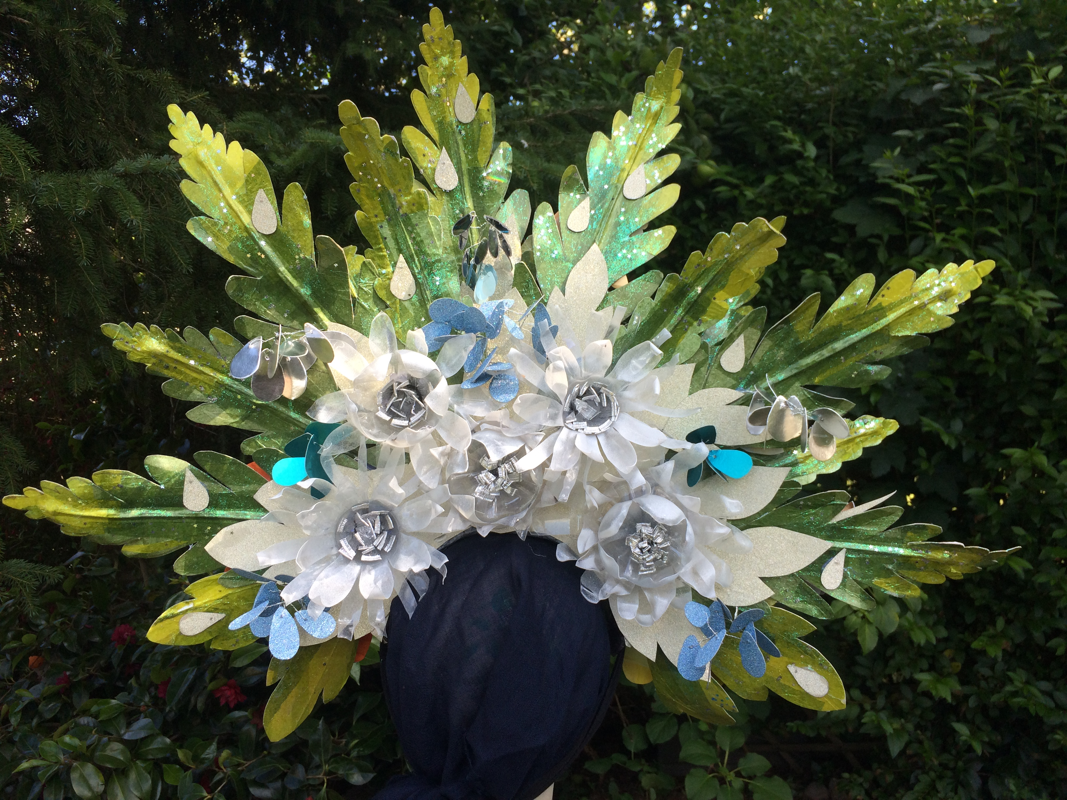
EMCCAN CIC
East Midlands Caribbean Carnival Arts Network
Tribute to Jess Kemp
Carnival in Education programme 2018/19
Carnival is an inclusive and accessible artform
Paul Hamlyn Foundation – Explore and Test
Look in more depth at how Caribbean Carnival could be delivered in schools
Artists in Residence in 2 schools
Two different approaches

Slide 3
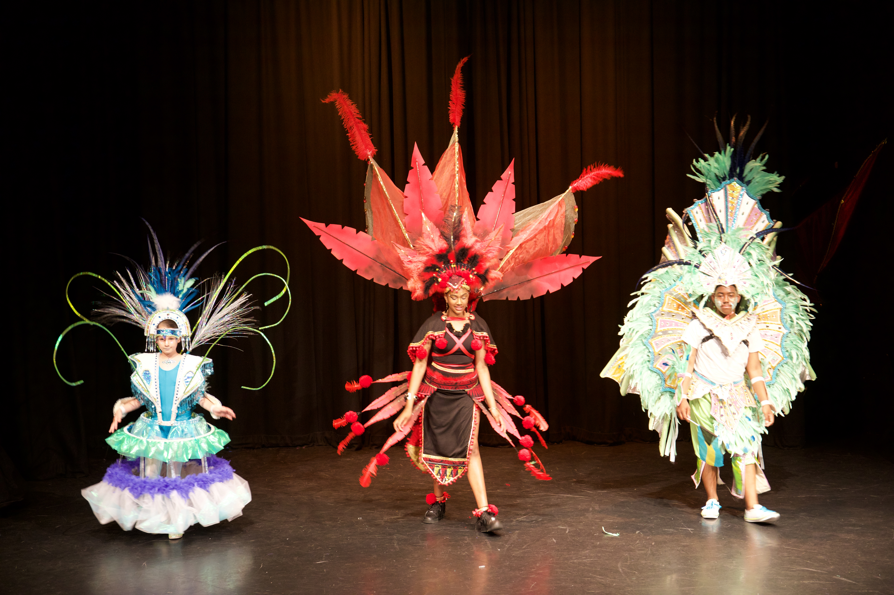
Two theories
Loose Parts Theory – Child led approach
Artist in Residence – Jess Kemp
Working with SEND children, mainstreaming through Caribbean Carnival Arts
Whole School Approach – various subjects
Artist in Residence – Charis Betts
Enhancing the curriculum and aiding children’s understanding of the National Curriculum through Caribbean Carnival Arts

Slide 4
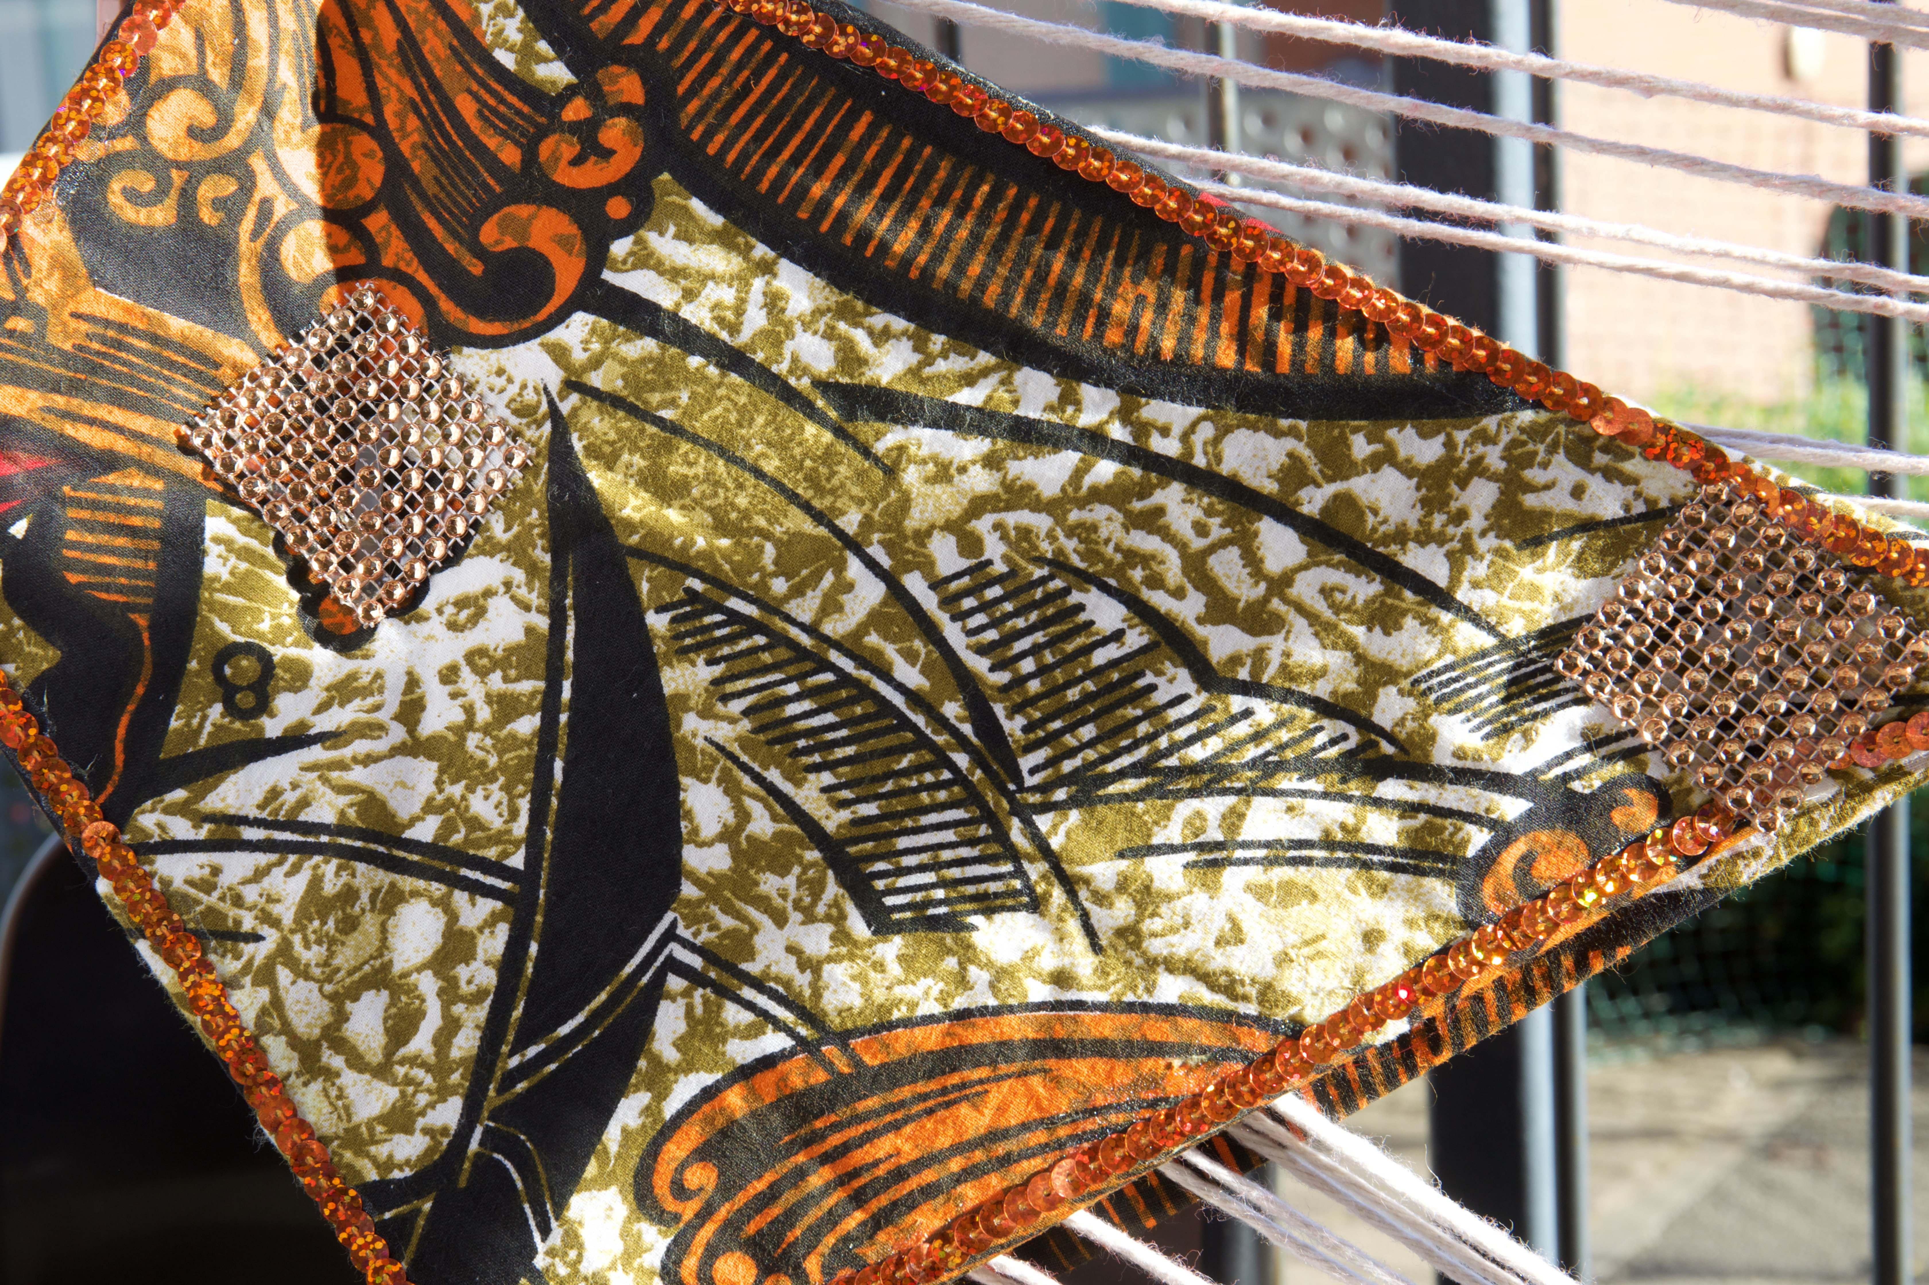
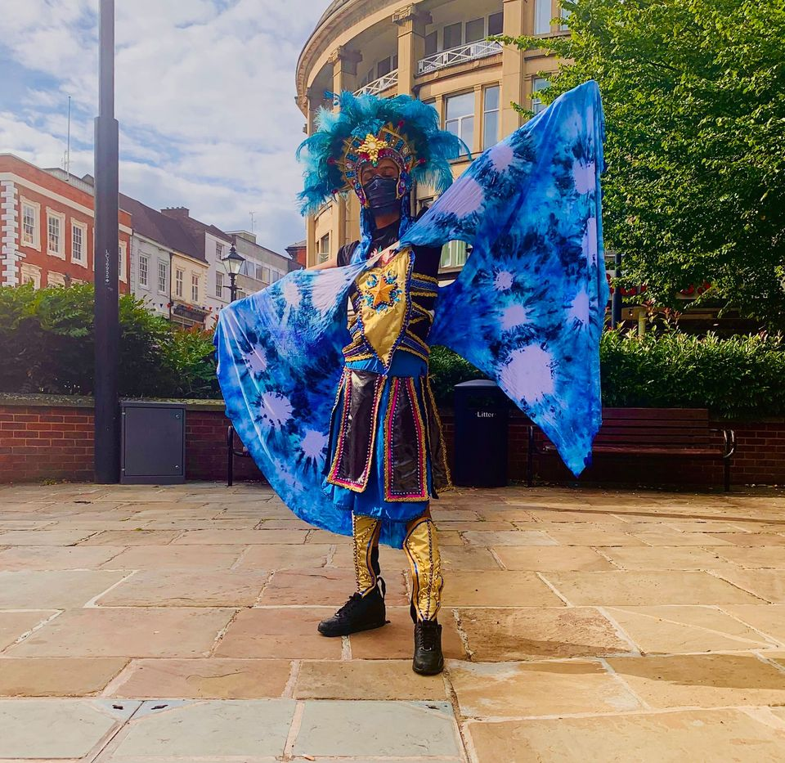
Loose Parts Theory
General overview
How it worked in the school
Feedback from those involved
Next steps

Slide 5
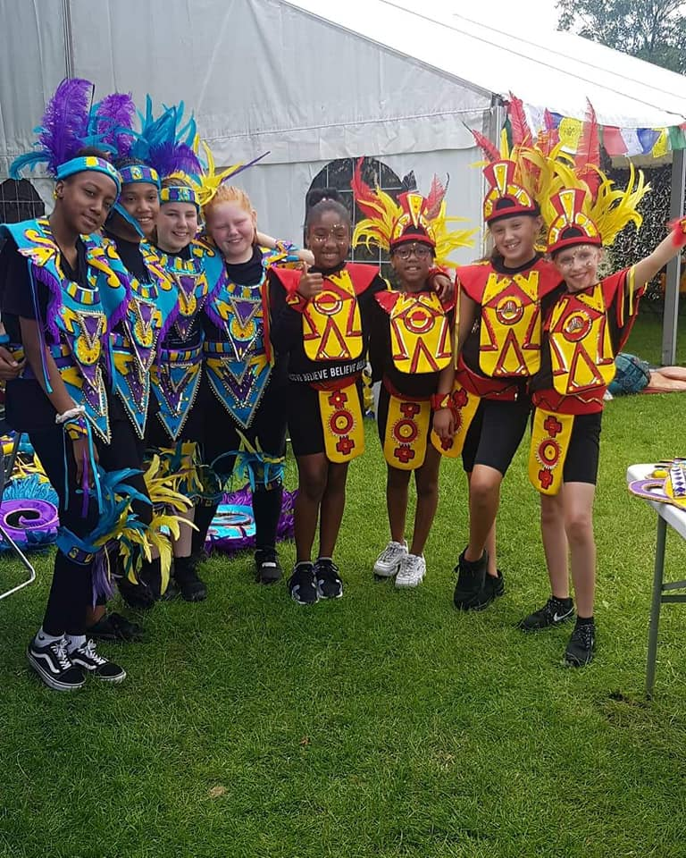
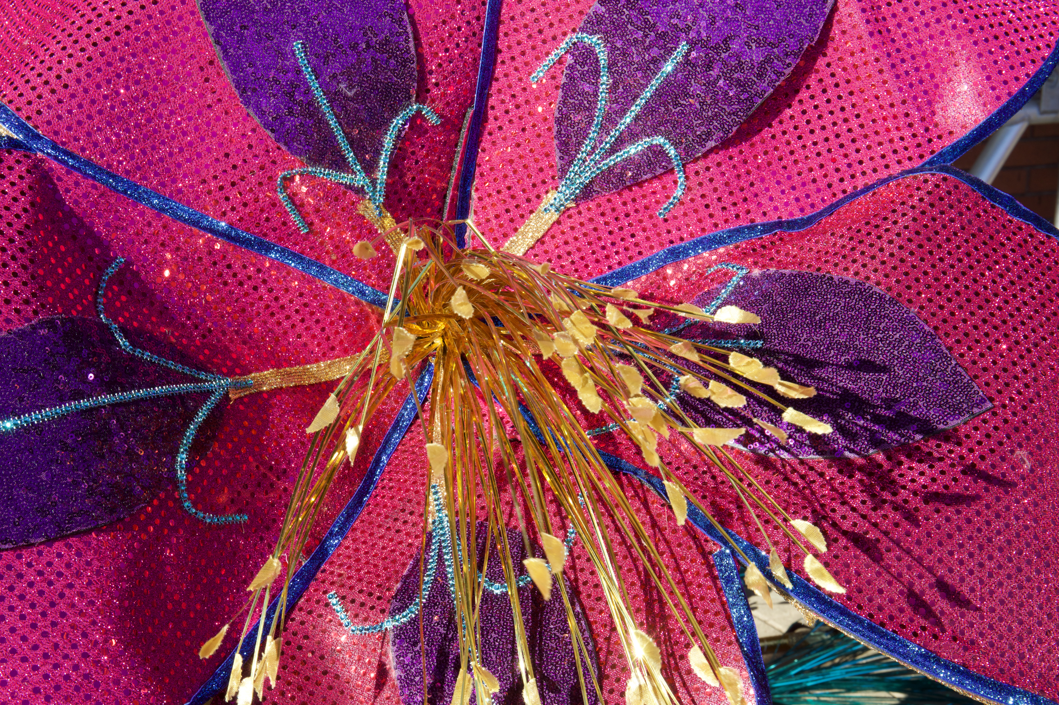
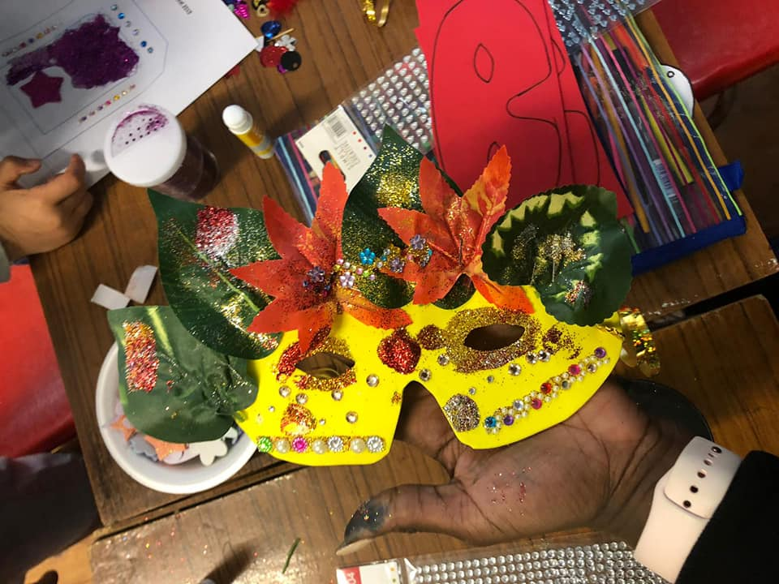
Whole School Approach
Subjects explored through Caribbean Carnival Arts
Feedback from artists and teachers
Use of identity and masks

Slide 6
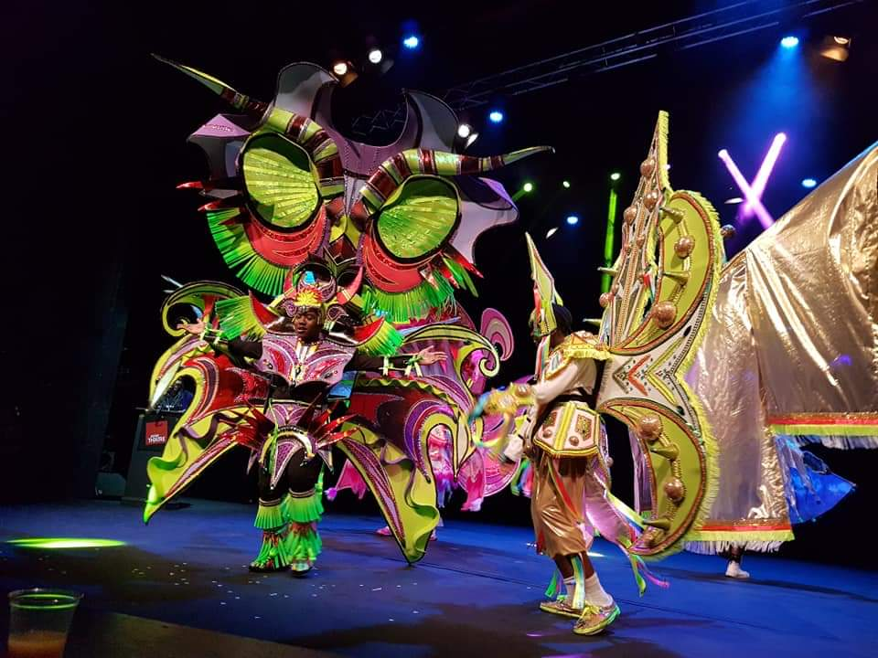
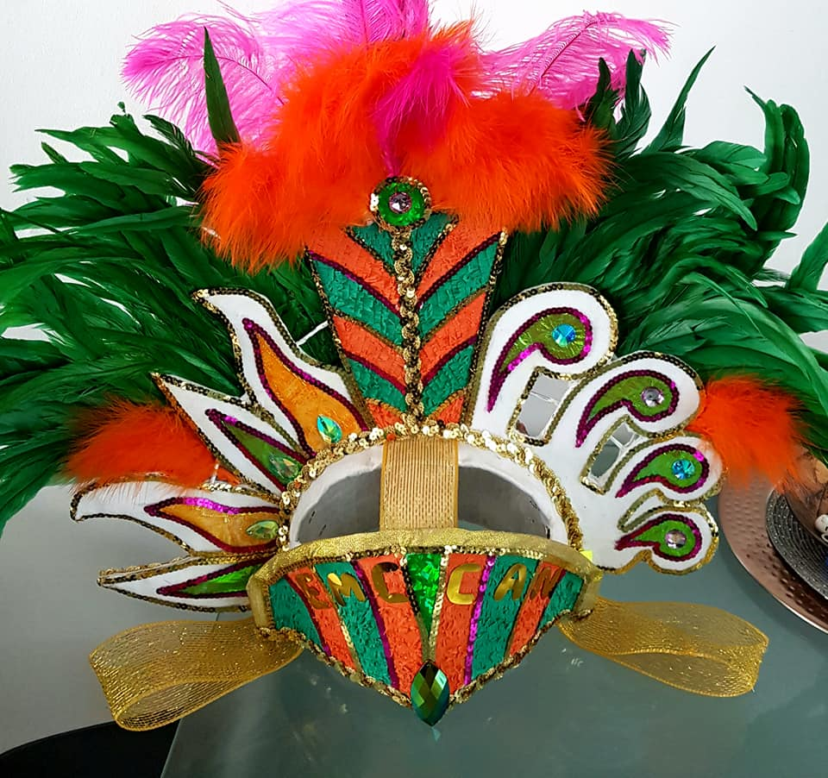
Next steps
Richard Fletcher Evaluation
Paul Hamlyn Phase 2

Slide 7

A Caribbean Carnival Curriculum

